Slide 1


PHARMACY MANAGEMENT SYSTEM
Sai Thejas Chillagatu Ramesh
Veera Venkata Jagannadham Ganta
Rama Koteswara Rao Kolla
Rajashekhar Gali

Slide 2
Introduction
The main aim of the project is to apply technology is supporting the pharmacist and the store to reduce the human effort on searching and automation of the billing. Medical information system is a client/server based application . An Interactive application for managing both stock and billing which helps in maintaining the records of the medicine, the users and store details and also reduce the work of searching the medicine.

Slide 3
Goals
Admin can login through the webpage.
Admin can view the stock details.
Inventory of medicines in the pharmacy can be inserted into the database.
Admin can add new medicines and supplies.
Admin can edit/delete stock details.
Admin can enter customers and sales details.

Slide 4
Objectives
To easily maintain stocks in the pharmaceutical store.
To keep track of sales.
To keep track of medicines and their suppliers.
To keep track of customer details.
To reduce paperwork.

Slide 5
Software Context
Database: phpMyAdmin
User Interface: Google Chrome
Server: XAMPP Server
Front End Design: HTML
Back End Design: php
Code Developing Software: phpstorm

Slide 6
Software Requirements

Slide 7
User Interface: HTML
The user interface in the industrial design field of human-computer interaction in the space where interaction between humans and machine occur. The goal of this interactions is to allow effective operations and control of the machine from the human end, whilst the machine simultaneously feeds back information the aids the operators decision making process. In this particular project, we used HTML as user interface tool. The main goal of this HTML user interface design is to produce a user interface which makes it easy efficient, and enjoyable to a machine in the way which produces the desired result. This generally means that the operator needs to provide minimal input to achieve the desired output, and also that the machine minimizes undesired outputs to the human.

Slide 8
Overview of MySQL
MySQL is an open-source relational database management system that works on many platforms. It provides multi-user access to support many storage engines and is backed by Oracle. So, you can buy commercial license version from oracle to get premium support services. In this particular project, we need to implement mainly the two mentioned concepts such as
Stored procedure
Triggers

Slide 9
Stored Procedures
A stored procedure is a set of structured Query Language(SQL) statements with an assigned name, which are stored in a relational database management system as a group, so it can be reused and shared by multiple programs. Stored procedures can access or modify data in a database, but it is not tied to a specific database or object, which offers a number of advantages.

Slide 10
Triggers
A database trigger is a procedural code that is automatically executed in response to certain events on a particular table or view in a database. The trigger is mostly used for maintaining the integrity of the information on the database.

Slide 11
Overview Of PHP
PHP is an intuitive, server side scripting language. PHP also contains a number of extensions that make it easy to interact with databases, extracting data to be displayed on a web page and storing information entered by a website visitor back into the database. PHP consists of a scripting language and an interpreter.

Slide 12
Implementation
Tool Description:
The project is implemented using MySQL database along with PHP and HTML . In this project we use the different type of effects like HTML pages to demonstrate on the web page as a stand-alone or web based application. It is a three-tier architecture project. A three-tier architecture is a client-server architecture in which the functional process logic, data access, computer data storage and user interface are developed and maintained as independent modules on separate platforms. Three-tier architecture is software design pattern and a well-established software architecture.

Slide 13
Software Design

Slide 14
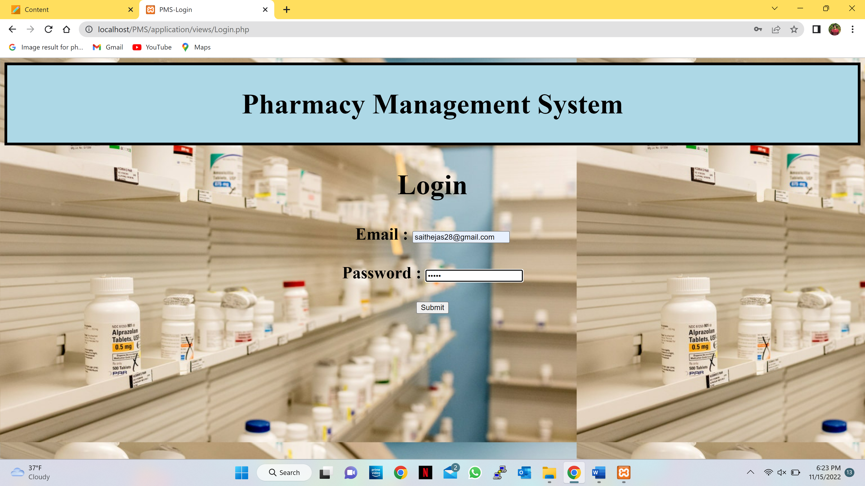
Project

Slide 15
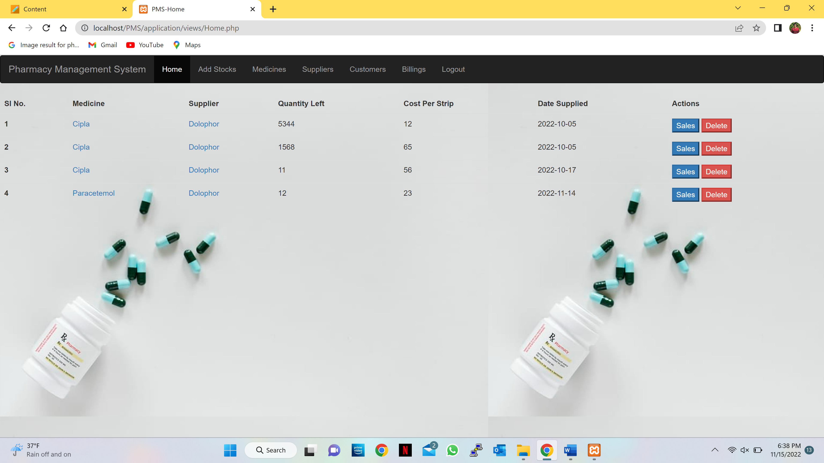
Project

Slide 16
Test Cases

Slide 17
Conclusion
The Pharmacy Management System is implemented using HTML as front end and PHP, MySQL in the back end. This system can serve as very good platform for pharmacy admins with the stock details displayed. Here admin can login to add medicines, suppliers and sales details of customers for keeping track of sales in the pharmaceutical store. Further this system can be used by many pharmacy retail shops.

